Slide 1





















GROCERY STORE MANAGEMENT
K. Hemanth
Batch : 456

Slide 2

AGENDA
Business Problem
Problem Statement
Objective
Data Overview
Er Diagram And Relationships
Analysis Questions
Challenges
Conclusion

Slide 3
Business Problem
Organizations generate large volumes of data from various sources such as sales, customers, and operations.
Much of this data is not properly analyzed or utilized.
Lack of structured data processing leads to poor decision-making.
Businesses struggle to identify trends, performance gaps, and growth opportunities.
Absence of data-driven strategies impacts profitability and operational efficiency.

Slide 4
Problem Statement
Raw and unstructured data needs to be converted into meaningful insights.
Data must be cleaned, organized, and analyzed effectively.
Trends and patterns must be uncovered to support strategic decisions.
The goal is to enable data-driven decision-making to improve business performance.

Slide 5
Objective
Evaluate Sales Patterns.
Highlight Best-Selling Products.
Analyze High-Performing Categories.
Assess Supplier Efficiency.
Support Strategic Decisions with Data.
Track Revenue Growth Trends.

Slide 6
Data Overview
The Dataset Consists Of 7 Tables
Products.
Suppliers.
Employees.
Orders.
Order Details.
Customers.
Categories.

Slide 7
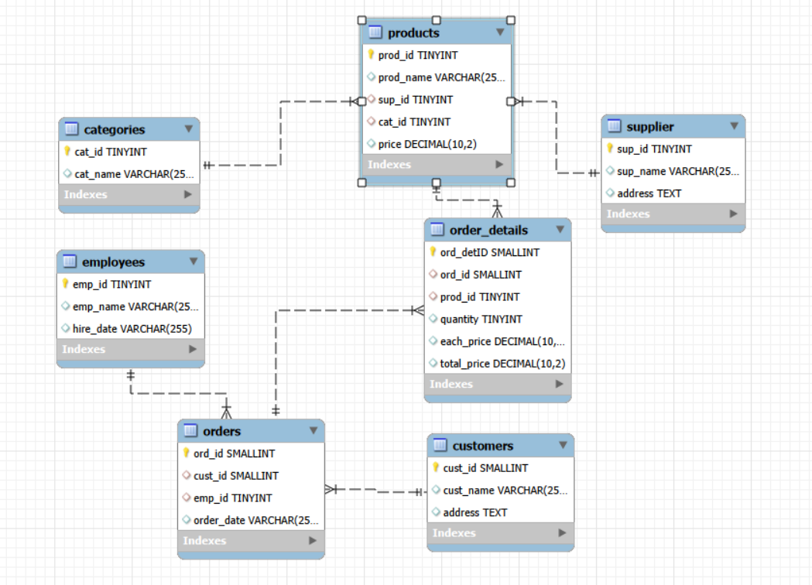
ER DAIGRAM

Slide 8
ER Diagram Relationships
One Supplier →Many Products
One Category → Many Products
One Customer → Many Orders
One Employee → Many Orders
One Order → Many Order Details
One Product → Many Order Details
This ER diagram represents one-to-many relationships where a single entity instance (like Supplier, Customer, or Order) is associated with multiple related entity instances (like Products, Orders, or Order Details).

Slide 9
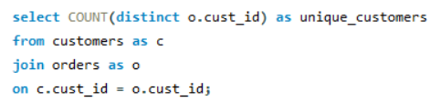

Analysis Questions
1. Customer Insights
How Many Unique Customers Have Placed Orders?
Query :
Output :

Slide 10
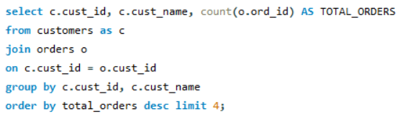
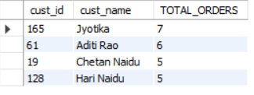
Which Customers Have Placed The Highest Number Of Orders?
Query :
Output :

Slide 11
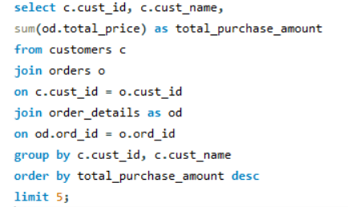
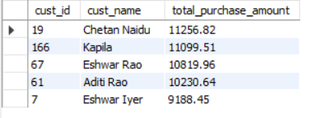
Who Are The Top 5 Customers By Total Purchase Amount?
Query :
Output :

Slide 12
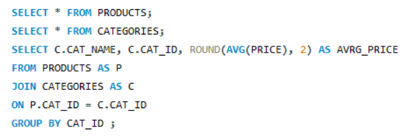
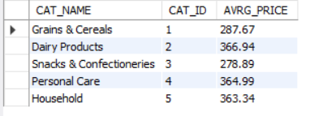
2. Product Performance
What Is The Average Price Of Products By Category?
Query :
Output :

Slide 13
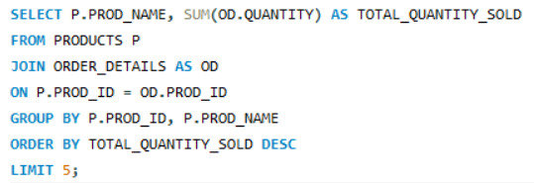
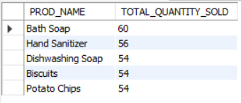
Which Products Have The Highest Total Sales Volume (By Quantity)?
Query :
Output :

Slide 14


3. Sales and Order Trends
How Many Orders Have Been Placed In Total?
Query :
Output :
What Is The Average Value Per Order?
Query :
Output :

Slide 15
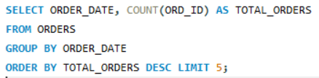
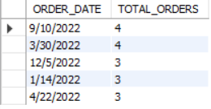
On Which Dates Were The Most Orders Placed?
Query :
Output :

Slide 16
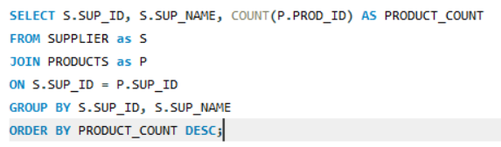
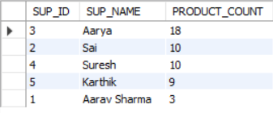
4. Supplier Contribution
Which Supplier Provides The Most Products?
Query :
Output :

Slide 17
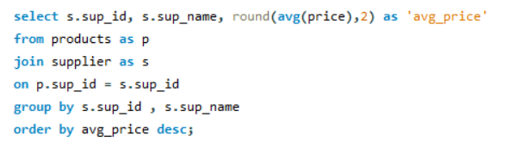
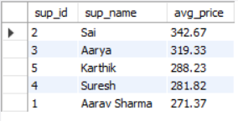
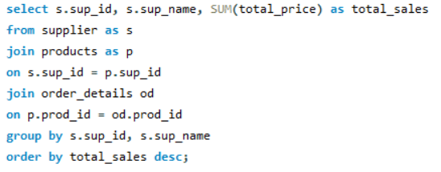
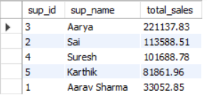
What Is The Average Price Of Products From Each Supplier?
Query :
Output :
Which Suppliers Contribute The Most To Total Product Sales (By Revenue)?
Query :
Output :

Slide 18
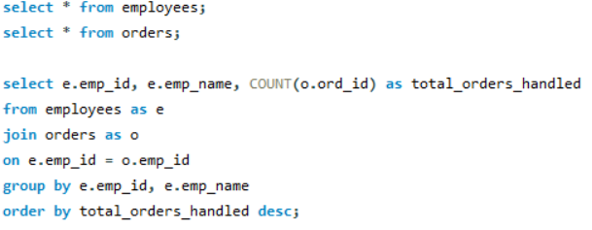
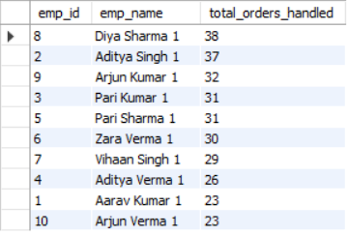
5. Employee Performance
Which Employees Have Handled The Most Orders?
Query :
Output :

Slide 19
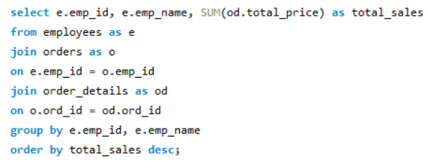
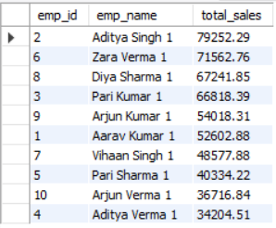
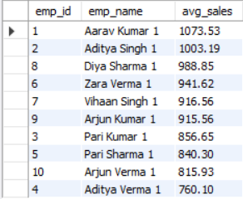
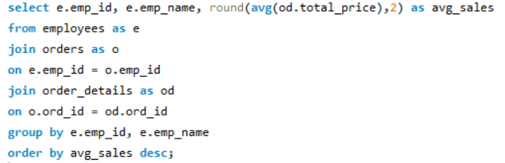
What Is The Total Sales Value Processed By Each Employee?
Query :
Output :
What Is The Average Order Value Handled Per Employee?
Output :
Query :

Slide 20
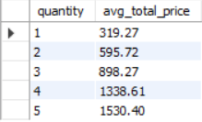
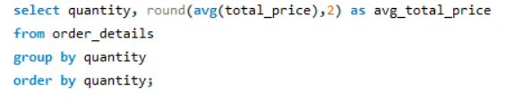
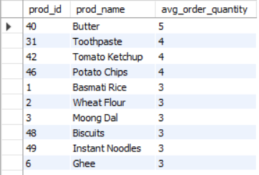
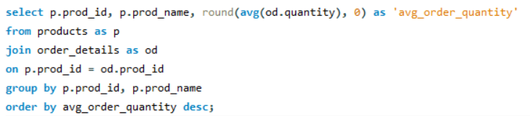
6. Order Details Deep Dive
What Is The Relationship Between Quantity Ordered And Total Price?
Query :
Output :
What Is The Average Quantity Ordered Per Product?
Output :
Query :

Slide 21
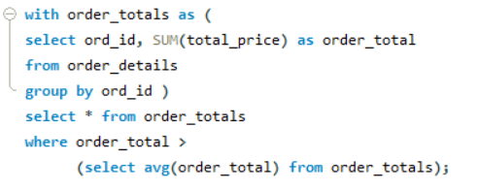
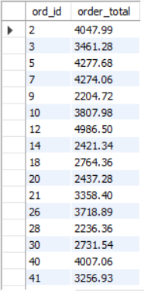
Find Orders Where Total Purchase Value Is Above The Overall Average Order Value.
Query :
Output :

Slide 22
Challenges
Crafted JOIN Queries To Combine Multiple Tables.
Utilized Aggregate Functions With Group By And Having For Data Summarization.
Compared Summarized Results Using Subqueries And Ctes.
Ensured Precise Revenue And Total Calculations.
Differentiated The Use Of Where And Having Clauses Effectively.

Slide 23
Insights
A small group of customers generates most of the total revenue.
Some products and categories perform better than others in sales and profit.
A few suppliers contribute the majority of product supply and revenue.
Sales trends show peak order dates and average order value patterns.
Employee performance affects overall sales and business efficiency.

Slide 24
Recommendations
Analyze revenue trends to forecast future growth.
Identify opportunities to increase customer retention.
Detect sales fluctuations and seasonal patterns.
Support management with clear dashboards.
Optimize pricing strategies based on sales performance.
Identify cost-saving opportunities across operations.

Slide 25
Conclusion
Analyzed sales, customer, product, supplier, and employee data using SQL queries.
Used joins, aggregations, subqueries, and CTEs to solve retail business problems.
Identified key revenue drivers, top customers, and best-performing products.
Showed how a well-structured database supports accurate reporting and insights.
Demonstrated SQL’s role in data-driven sales growth and operational improvement.

Slide 26


